Slide 1
5 Things You Need To Know Before You Buy Edtech
Anne-Marie Scott
#OTESSA23

Slide 2
5 Things You Need To Know
I think
^
Edtech is big business
Edtech is not a tool
Edtech is not neutral
Edtech is killing us
Edtech procurement is broken

Slide 3
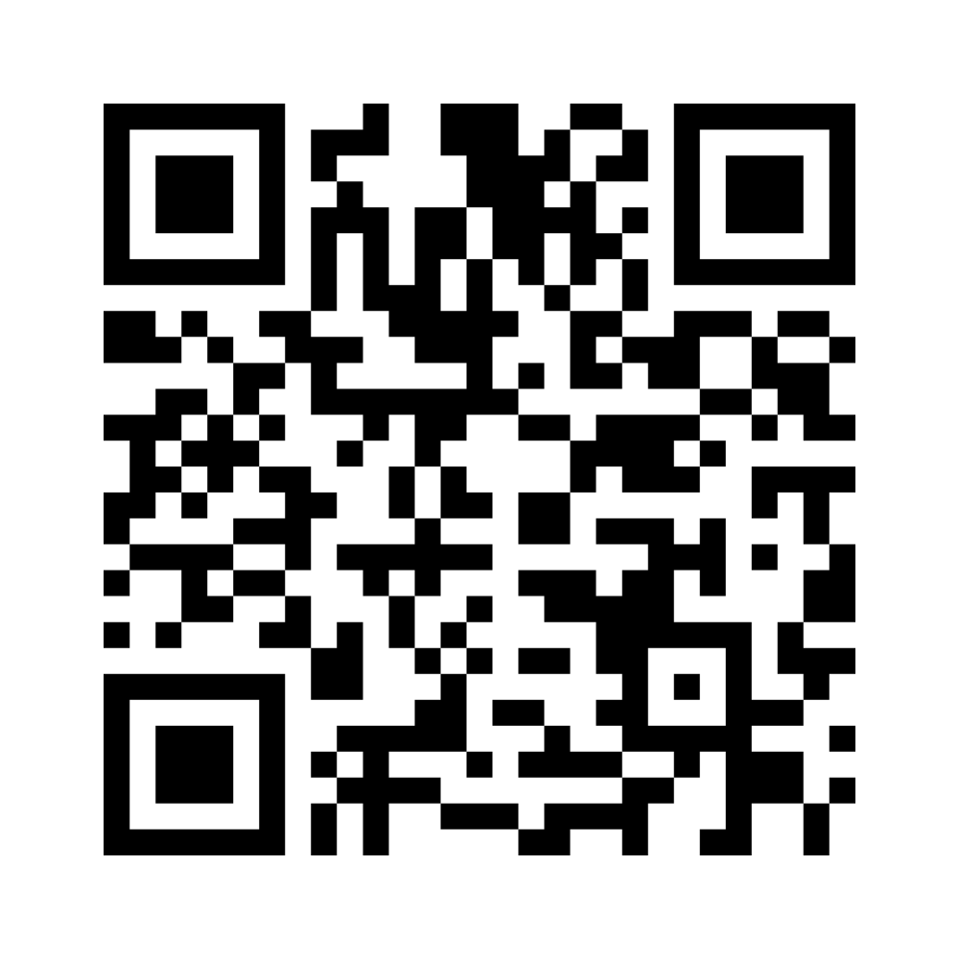
Your Experience
www.menti.com
6604 9975

Slide 4
Edtech is big business
There are a variety of economic interests influencing the technologies we use.

Slide 5
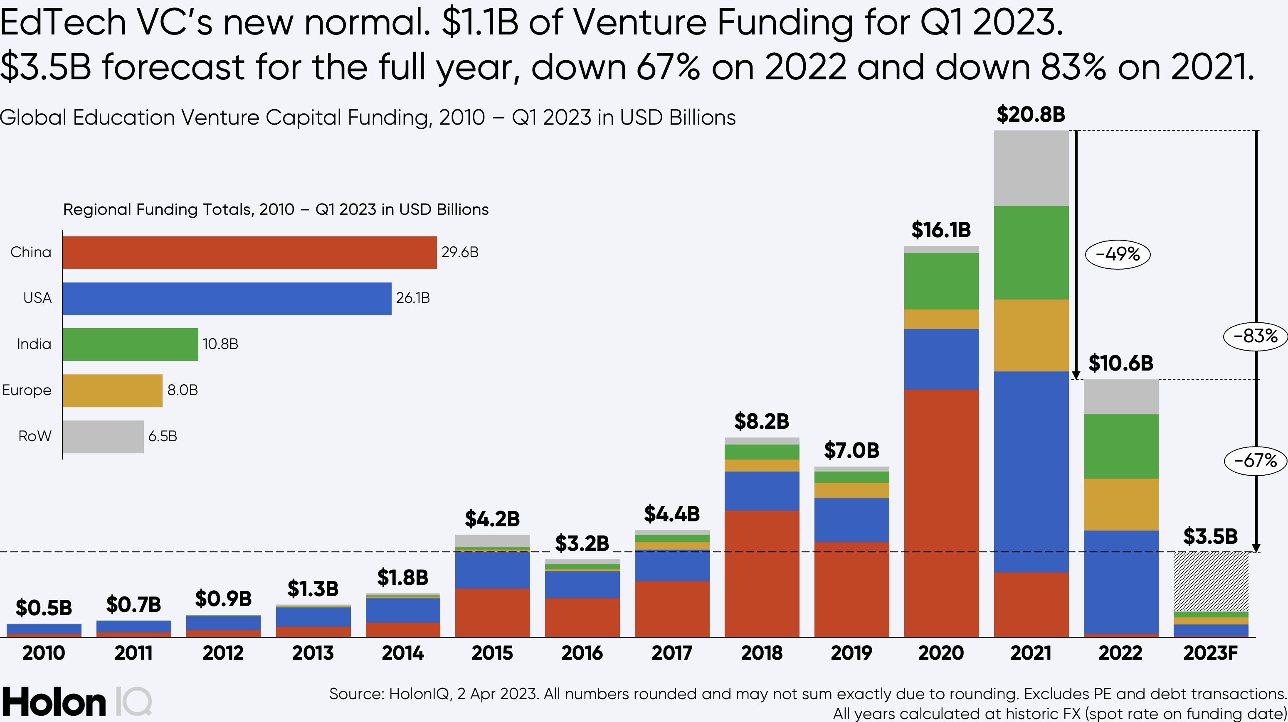
Making Markets
“The intentions of financial investors are necessarily not the same as those of educators, governments and students, and yet they are seeking to become central to directing flows of investment in the education arena.”
Keri Facer, Futures in education: Towards an ethical practice (https://unesdoc.unesco.org/ark:/48223/pf0000375792)

Slide 6
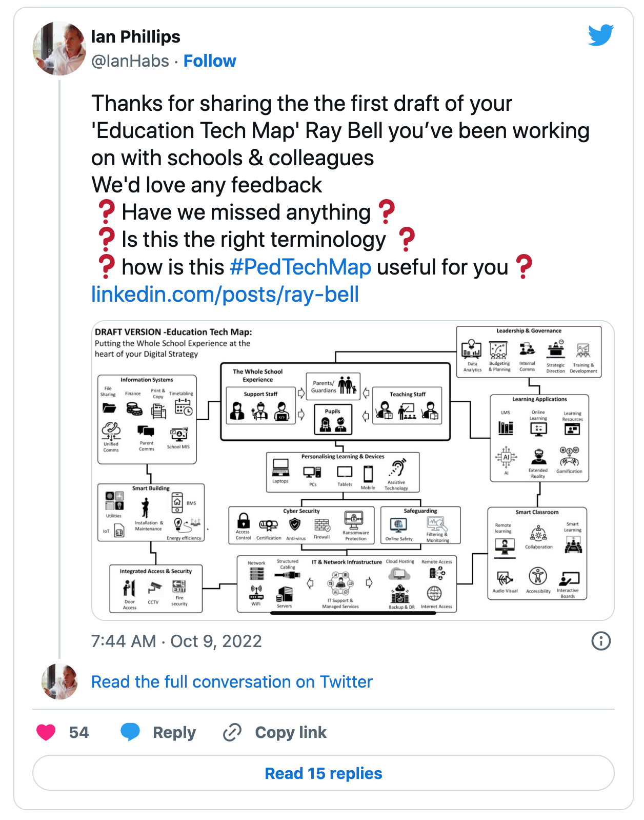
Digital Transformation
“Multidisciplinary teams, incorporating traditional corporate roles and digital skills, are essential for successful digital institutions”
Greenway, Andrew; Terrett, Ben; Bracken, Mike. Digital Transformation at Scale: Why the Strategy Is Delivery . London Publishing Partnership.

Slide 7
Supporting Growth

Slide 8
Edtech companies have a vested interest in influencing institutions and making markets for edtech.
Institutions have vested interests in edtech to support digital transformation visions.

Slide 9
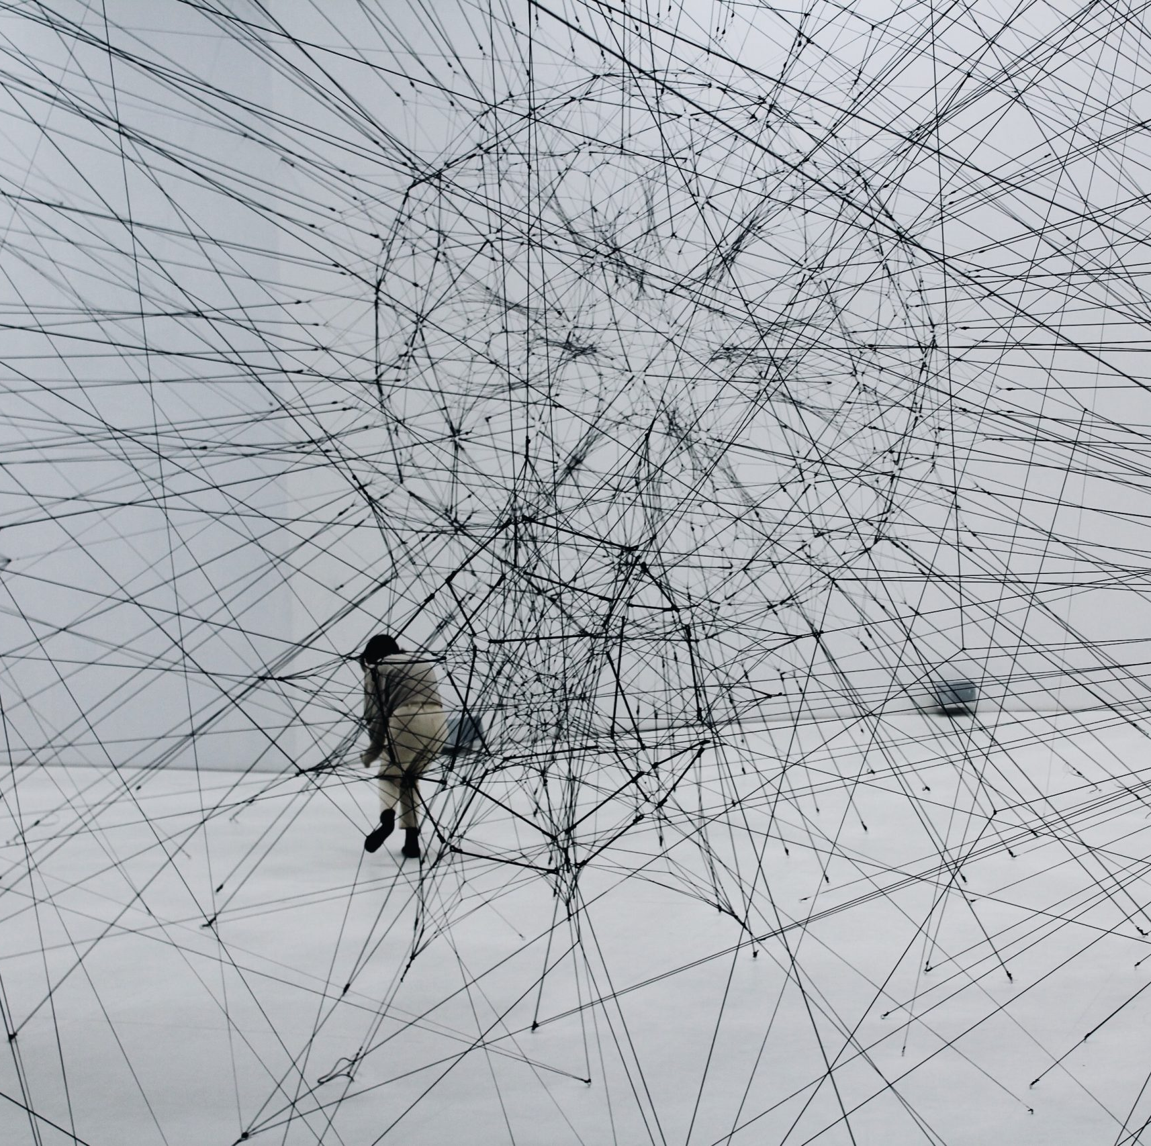
Edtech is not a tool
The technologies we use are matters of quality.

Slide 10
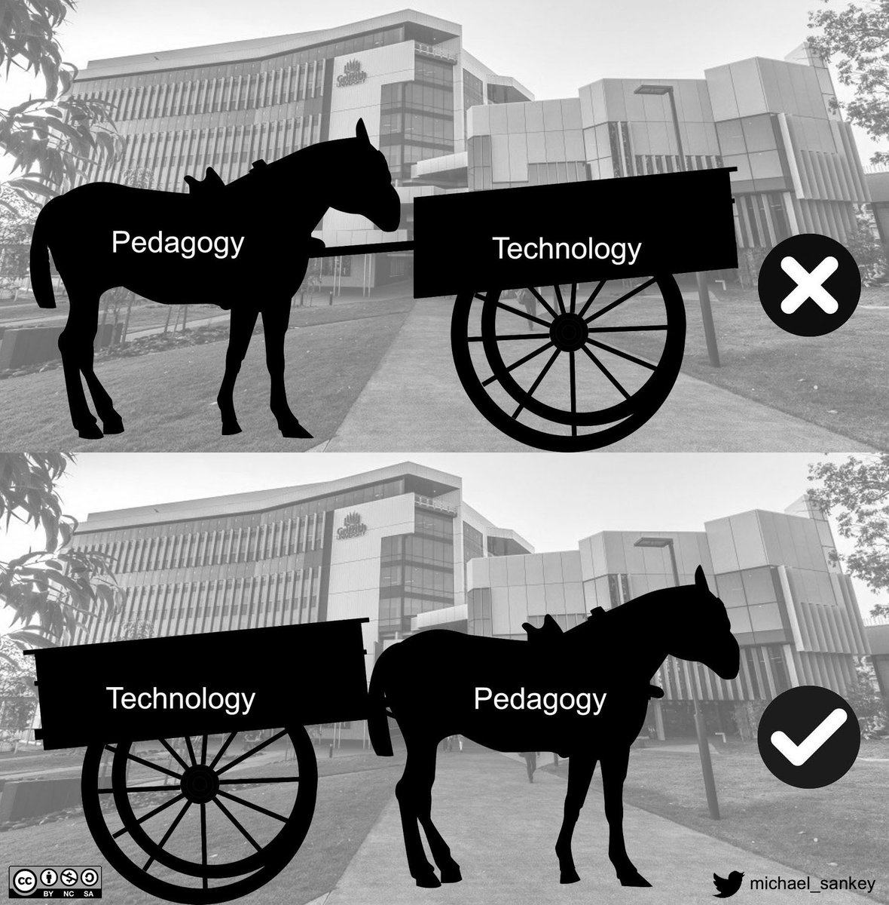
Entanglements
“As researchers and practitioners of digital education, we need to move away from our over-emphasis on how technology acts on education, or how education can best act on technology. Let us rather acknowledge that the two are co-constitutive of each other, entangled in cultural, material, political and economic assemblages of great complexity.”
Bayne, S. (2014) What’s the matter with ‘Technology Enhanced Learning’?. Learning, Media and Technology, DOI: 10.1080/17439884.2014.915851. https://doi.org/10.1080/17439884.2014.915851

Slide 11
Fawns, T. An Entangled Pedagogy: Looking Beyond the Pedagogy—Technology Dichotomy. Postdigit Sci Educ 4, 711–728 (2022). https://doi.org/10.1007/s42438-022-00302-7

Slide 12
Good use of educational technology is not as simple as picking the right technology and training people on how to use it.
Quality assurance processes needs to extend beyond what we do within educational technology systems to how we choose them in the first place.

Slide 13
Edtech is not neutral
Edtech is driven by political ideologies of what education is about and for, and is not an ethics free zone.

Slide 14
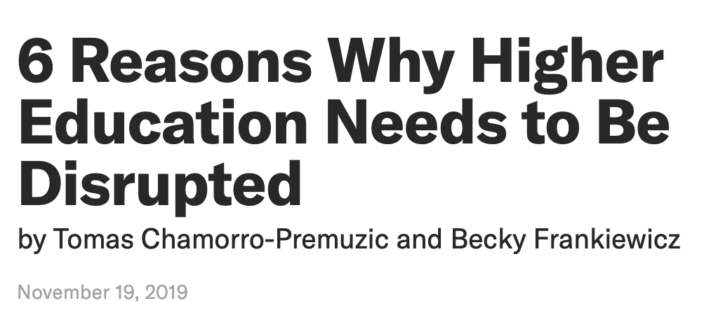
Politics
“The rise of edtech is underpinned by ideology: Edtech is financially driven, adheres to privatisation of longstanding public structures, desires automated or prepackaged contents and processes, and envisions technology as a solution in and of itself.”
Veletsianios, G., & Moe, R. (2017, April 10). The Rise of Educational Technology as a Sociocultural and Ideological Phenomenon. Educause Review. https://er.educause.edu/articles/2017/4/the-rise-of-educational-technology-as-a-sociocultural-and-ideological-phenomenon
(https://hbr.org/2019/11/6-reasons-why-higher-education-needs-to-be-disrupted)

Slide 15
Risky Business
(https://www.edsurge.com/news/2022-08-25-college-s-use-of-exam-proctoring-software-to-scan-rooms-violated-privacy-rights-judge-finds)

Slide 16
Risky Business
“Despite the relatively prosaic nature of educational technology as a field of study, online proctoring was a contentious topic to be researching during 2020.”
Selwyn, N., O’Neill, C., Smith, G., Andrejevic, M., & Gu, X. (2023). A necessary evil? The rise of online exam proctoring in Australian universities. Media International Australia, 186(1), 149–164. https://doi.org/10.1177/1329878X211005862

Slide 17
Edtech is complicit in narratives of disruption and presented as a ”solution” to a problem.
Ethics are a structural consideration in one area of education, and a risky business to engage with in another.

Slide 18
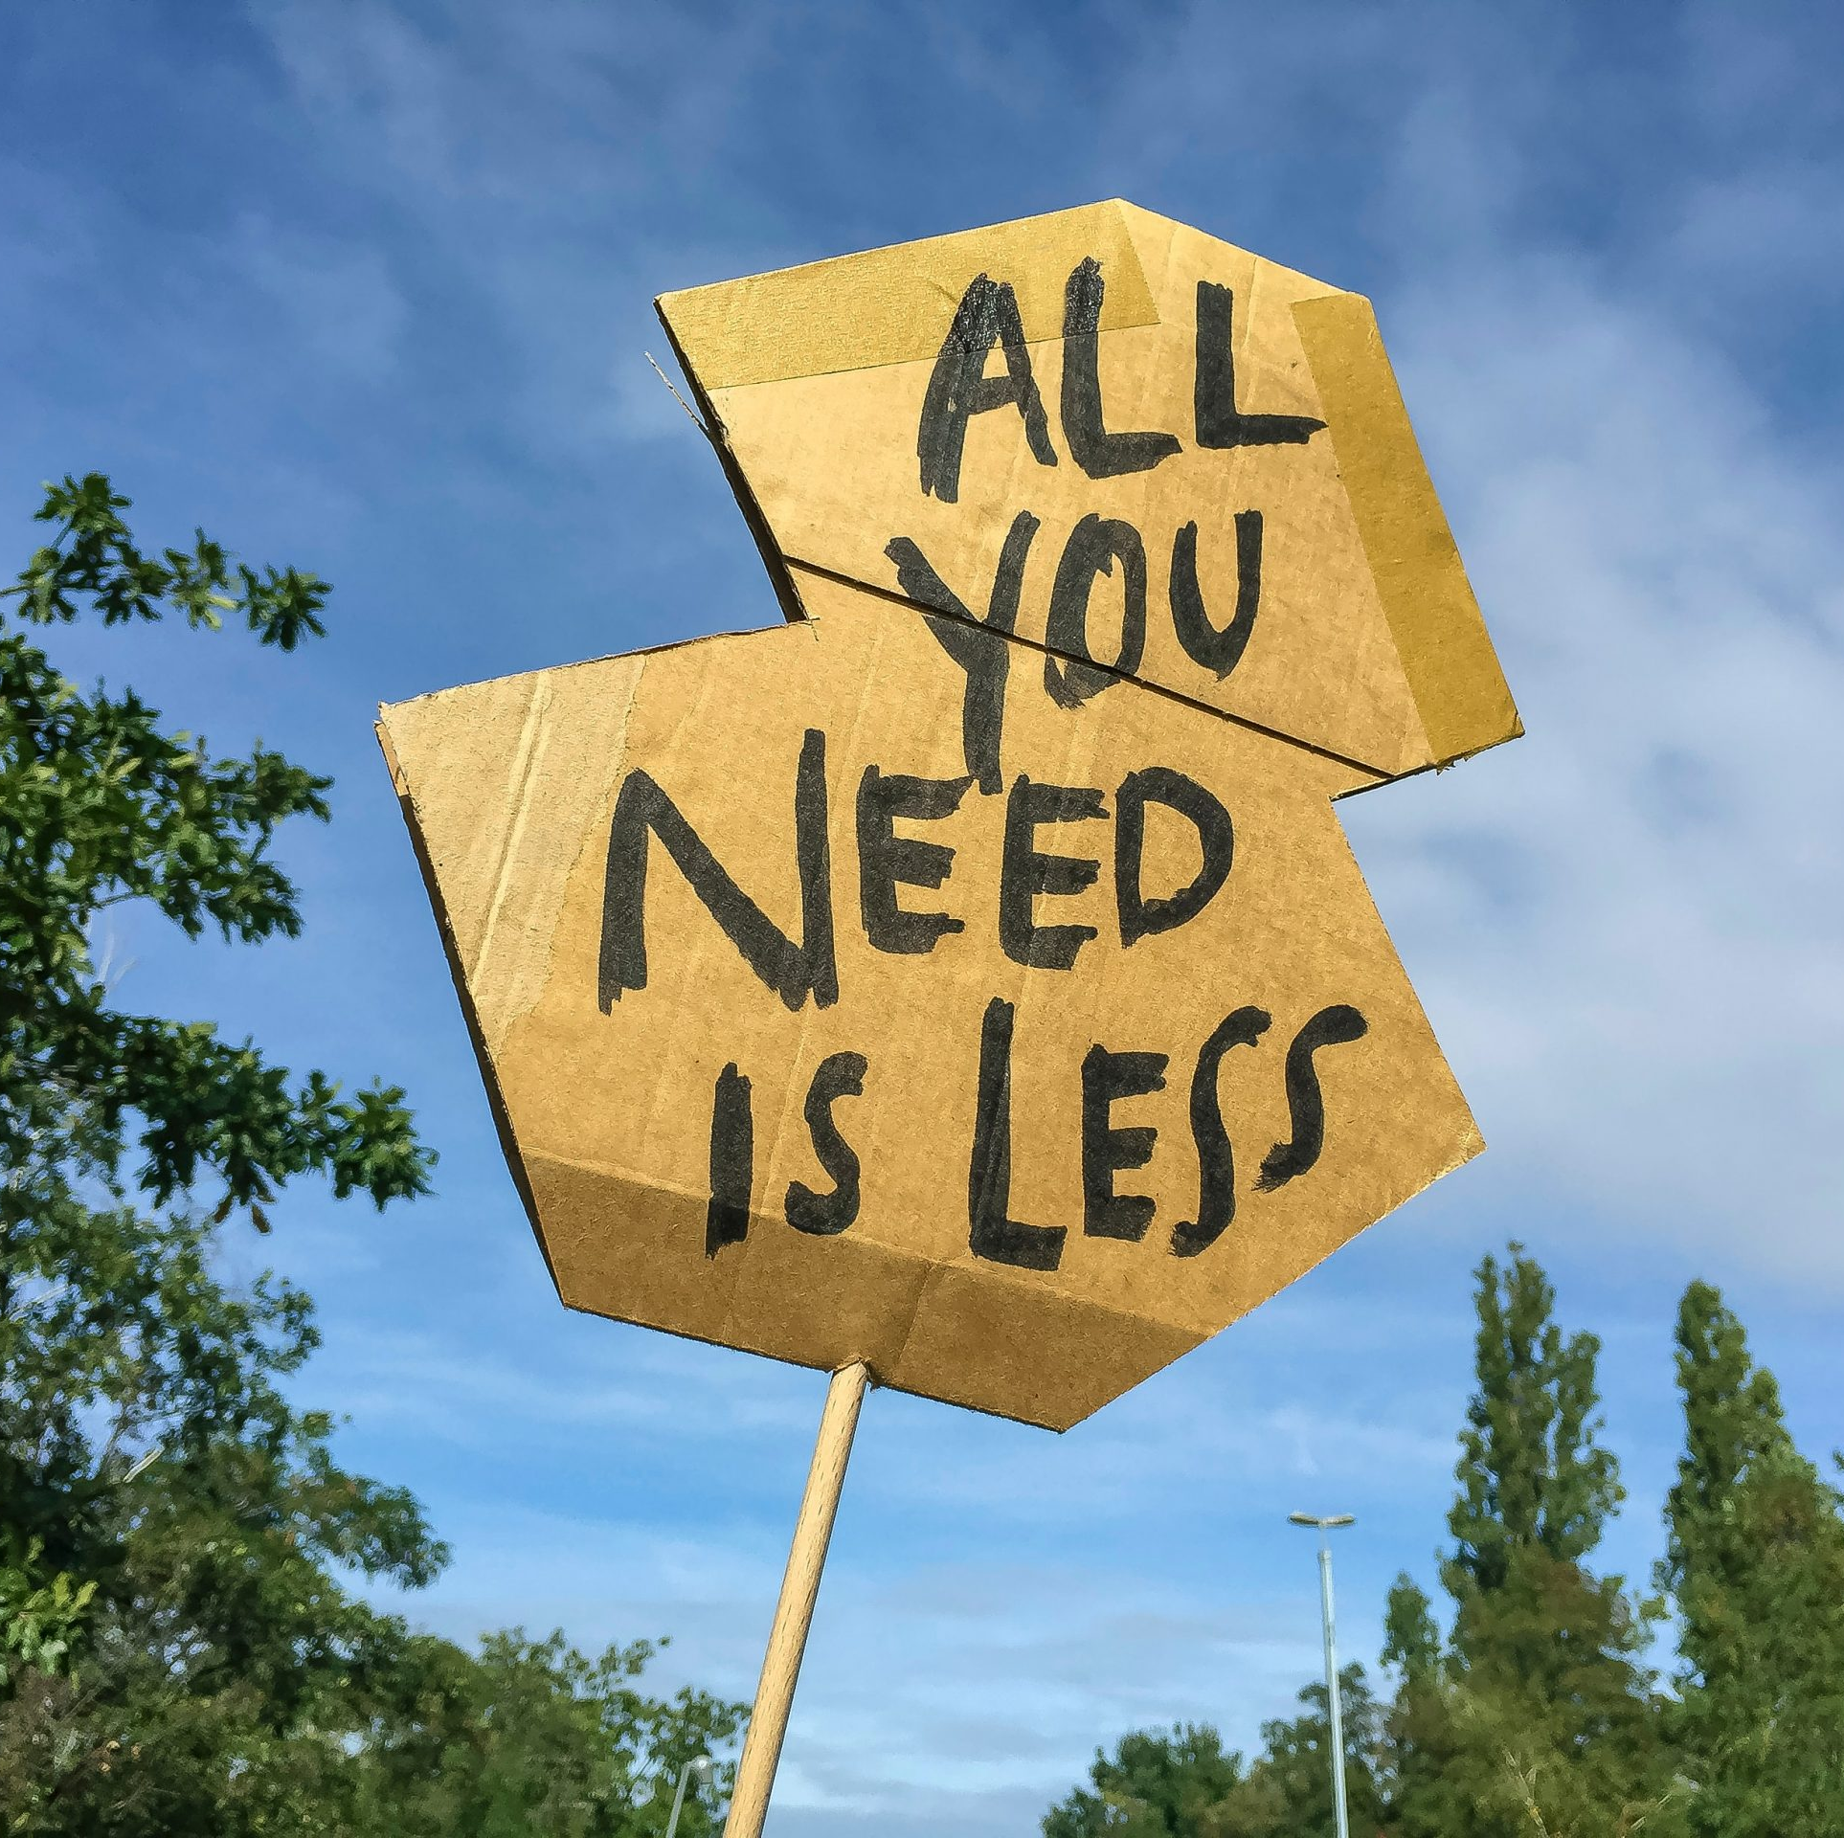
Edtech is killing us
We live in a period of edtech excess that is fuelling increasing disadvantage and climate crisis.

Slide 19
Talk by Neil Selwyn, given to Centre for Research in Digital Education at University of Edinburgh: Studying digital education in times of climate crisis: what can we do?

Slide 20
Less tech, more just outcomes
Where does OER fit?
What about our commitments to reconciliation (which has to include responsible use of natural resources)?
Just how do we reach some of the most marginalised learners in Canada?

Slide 21
Ecocritical Awareness
“This observation means that the reorientation of the field of educational technology to reconceptualize it’s relationship with the environment is inherently bound up with its relationship to social justice in a globalized world.”
Werse, N. R. (2023). The quest to cultivate an ecocritical awareness in educational technology scholarship: A question of disciplinary focus in the age of environmental crisis. British Journal of Educational Technology, 0, 1–17. https://doi.org/10.1111/bjet.13327

Slide 22
Digital Literacies
“It is clear that academics and policy makers are committed to the development of digital literacy, and much work has been done to progress the field over the past number of decades. However, it appears that the impact of users’ digital lives on the environment has been largely left out of the debate and area of focus”.
Tiernan, P. (2022). Gently down the stream(ing): Can digital literacy help turn the tide on the climate crisis? Nordic Journal of Digital Literacy, 17(3), 182–189. https://doi.org/10.18261/njdl.17.3.4

Slide 23
Should we be assessing the environmental footprint of our courses as a design and quality assurance activity much like might assess accessibility?
Do we need more edtech?

Slide 24
Edtech procurement is broken
We lack robust frameworks to help us navigate this territory within edtech procurement.

Slide 25
What’s missing?
What is driving procurement?
Who benefits, and what are the costs (beyond financial)?
Can claims of efficacy be validated?
Risks of harm to staff and students?
Sustainability?

Slide 26
We have often given more ethical consideration to how we procure teabags than we have technology.

Slide 27
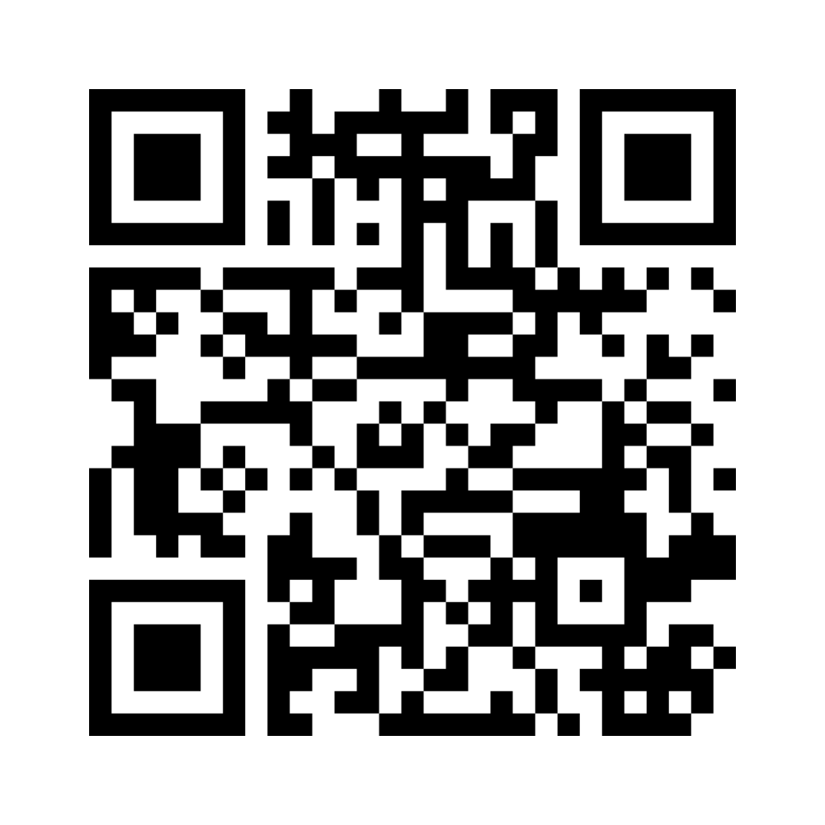
Good Education
www.menti.com
3962 9934

Slide 28
Bigger problems
As public procurement accounts for a substantial portion of the taxpayers’ money (approximately 12% of GDP and 29% of government expenditure in OECD member countries), governments are expected to carry it out efficiently and with high standards of conduct in order to ensure high quality of service delivery and safeguard the public interest.
(https://www.oecd.org/governance/ethics/public-procurement.htm)

Slide 29
Are we measuring what’s easy to measure?
Are we assessing risk appropriately?

Slide 30
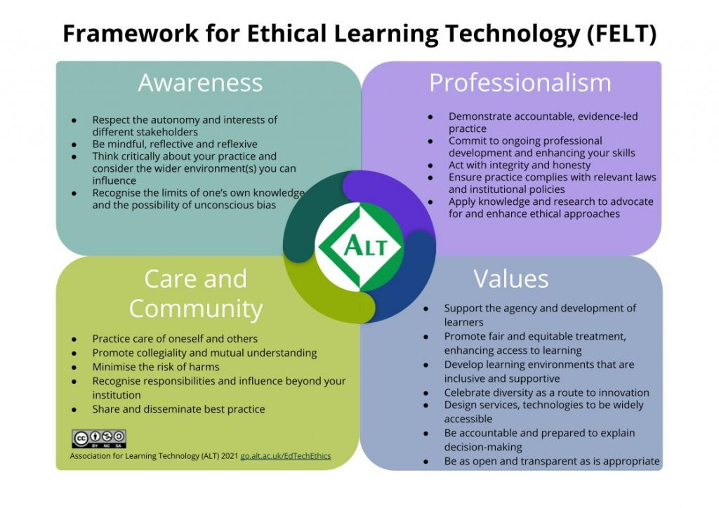
Solutions
(https://www.alt.ac.uk/news/media_releases/launching-alt%E2%80%99s-framework-ethical-learning-technology-felt)

Slide 31
Solutions
Education stakeholders need a standard to understand and choose edtech products with ease
There is a lack of benchmarks and standards across the edtech sector at national levels
Unregulated market increases the liability risks for schools
Roles and responsibilities with regards to edtech products remain unclear
Schools do not necessarily have the expertise and they cannot always afford it
There is a need for all edtech companies to adhere to commonly agreed policies, terms and conditions within national contexts
Edtech products should be licensed to operate in educational institutions
Hillman, V. (2022) Edtech procurement matters: it needs a coherent solution, clear governance and market standards, Social Policy Working Paper 02-22, London: LSE Department of Social Policy.

Slide 32
Embrace Constraints
“Constraints are not the forces of regression or punitive restriction we tend to think of them as…Their apparent limitations force us to question, surface, and challenge assumptions that, while they might have been reasonable once, are no longer useful strategic foundations for us.”
Morgan, A & Barden (2015) A Beautiful Constraint: How To Transform Your Limitations Into Advantages, and Why It's Everyone's Business, Wiley

Slide 33
Questions?
@ammienoot
https://ammienoot.com

